Slide 1
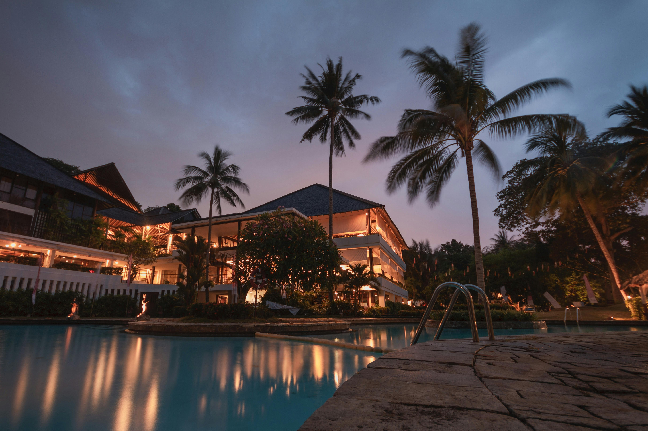
EDA On Hotel Booking
Present By: Guided By:
Neha Devmorari Abhishek Wavhal
Sandhya Rami
Nirmala Bohra

Slide 2
About The Dataset
This data set contains 1,19,390 observation for a city hotel and resort hotel.
Each observation represents a hotel booking between July 2015 to August 2017.
The dataset comprises detailed records of hotel reservations, capturing various aspects such as:
Lead Time: Time between the booking date and arrival date.
Guest Details: Information about adults, children, and babies per reservation.
Stay Duration: Number of weekend nights and weekday nights.
Booking Details: Including meal plans, room types, booking changes, and special requests.
Market Segment and Distribution Channel: How the reservation was made and through which channel.
Reservation Status: Current status of the reservation (e.g., canceled, checked out).
Financials: Average Daily Rate (ADR) and required car parking spaces.

Slide 3
Objective
The objective of this project is Explore and analyze the data to discover important factors that govern the bookings.
Define Your Business Objective.
Analyze and visualize the data on bookings of City Hotel and Resort Hotel to gain insights on the different factors that affect the booking and ADR.

Slide 4
Data Clean Process
Children Column 4 Error Remove(1,19,386)
Total People = Adults + Children + Babies
Country Column “NULL” Value Apply Filter than Remove .
Male Type Column “Undefined” Value to Replace With “Other”.
Distribution Channel Column “Undefined” Value to Replace With “Other”.
Agent Column “NULL” Value to Replace With “Other”.
Company Column “NULL” Value to Replace With “Other”.
Remove Duplicates .
Add Booking ID.

Slide 5
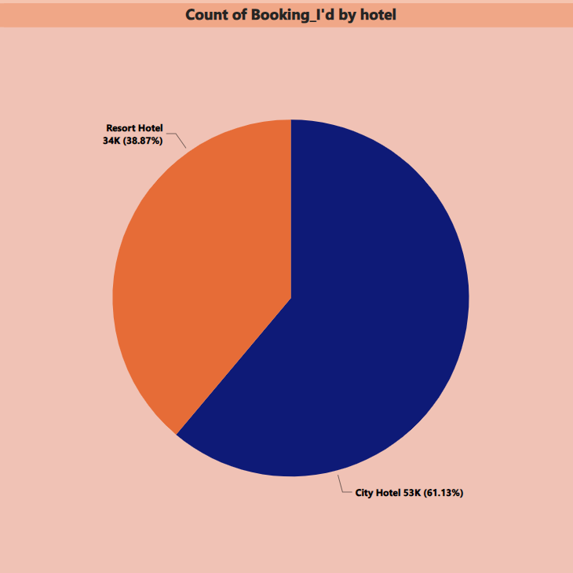
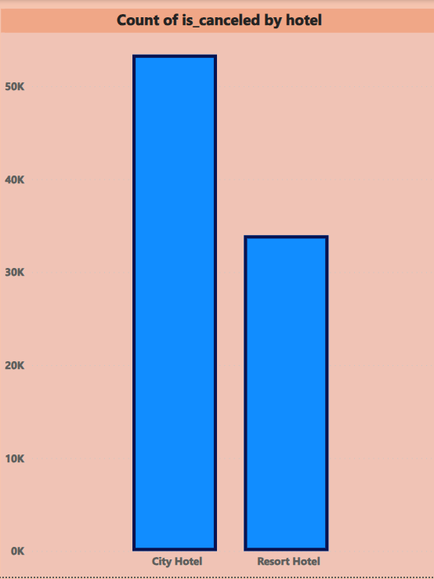
Booking Details
61.13% preferred city hotel and 38.87% preferred to book a resort hotel.
City Hotel can identify additional services to attract more guests and enhance revenue.
Resort Hotel can explore strategies to attract more customers and can also learn from the amenities offered by City Hotel to draw in clientele. Indeed, the insights gained contribute to a positive business impact.
City hotel has faced approx. 53k cancellations, while Resort hotel has faced 34k cancellations respectively.
Despite the City hotel's high number of bookings.

Slide 6
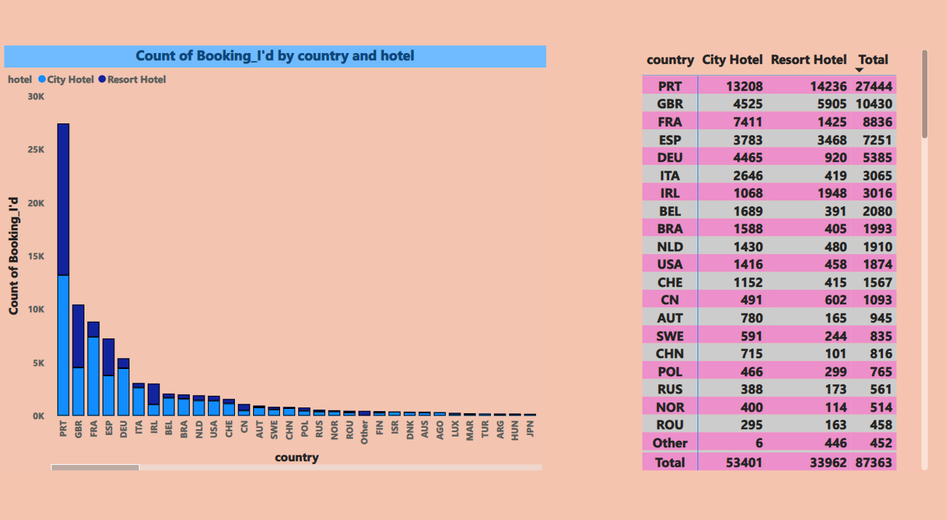
Booking By Country
Based on this graph, it is evident that Portugal has the highest number of people present.
.

Slide 7
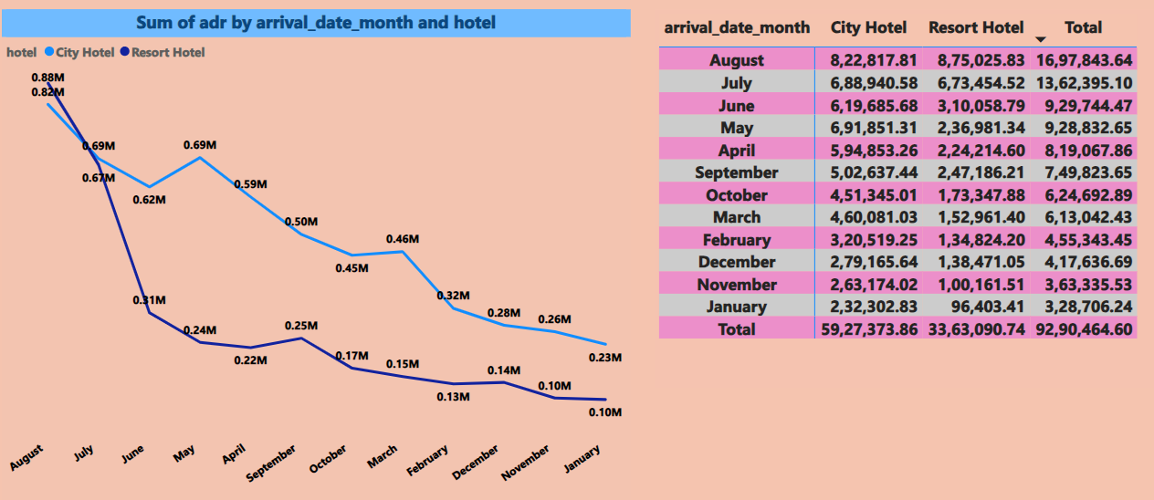
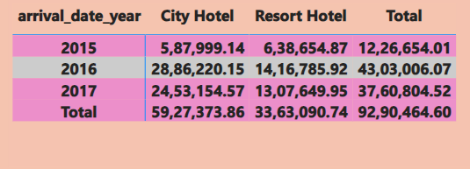
ADR Per Month & Year
Year wise ADR report shows maximum revenue is generated in year 2016
Month wise ADR report shows maximum revenue generated in August Month
Least ADR in November-January Month-Management can plan some scheme to increase revenue.

Slide 8
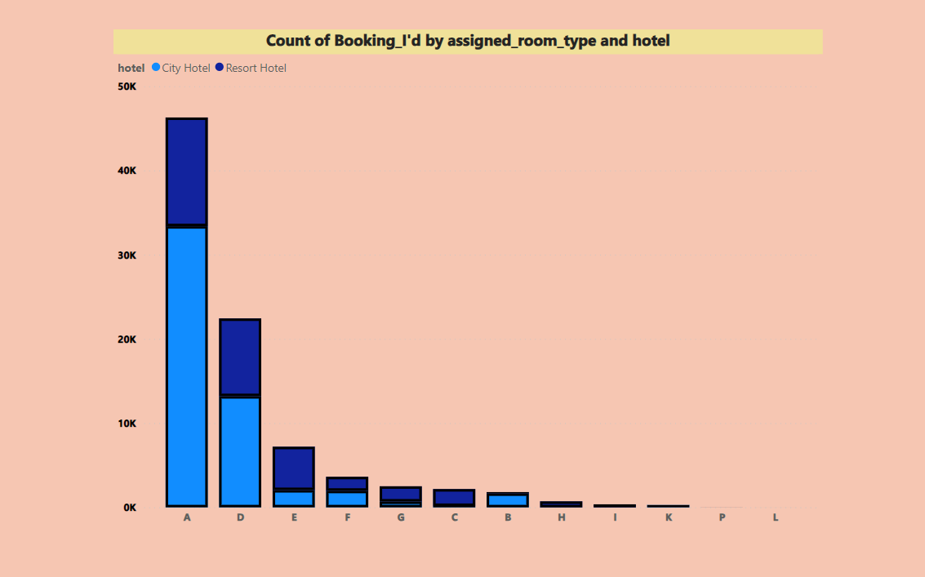
Preferred room type by guest
Above data shows ‘A-Type’ room Is more preferred by guests so we should increase number of ‘A-Type’ room in hotels.

Slide 9
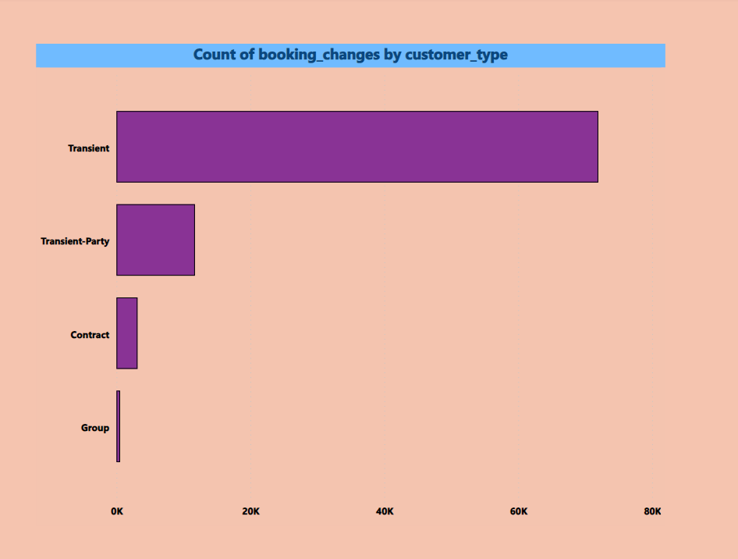
Consistency of booking
Above data shows that transient customers are most inconsistence in their decisions while group bookings have very less changes.

Slide 10
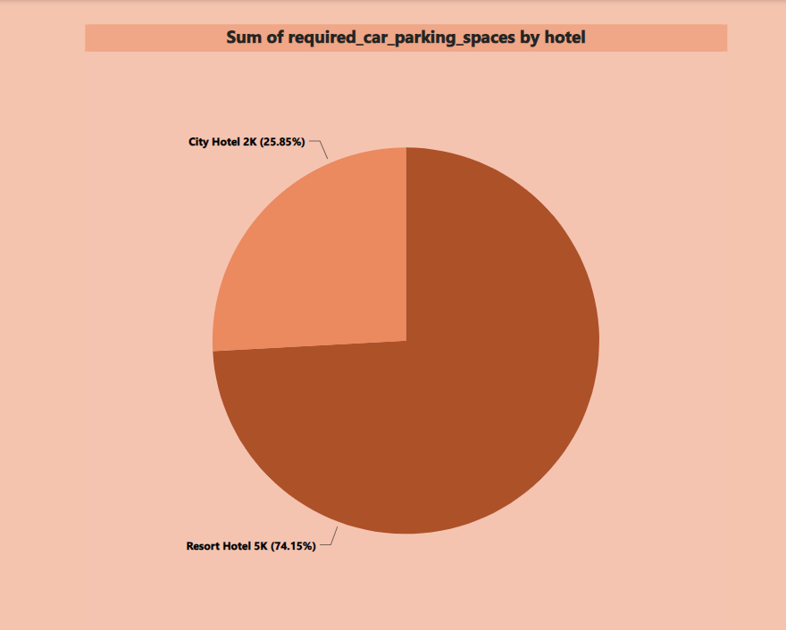
Car Parking Space
Above data shows number of car parking spaces booked in Resort in more compared to City Hotel.
Hotel Management can plan to provide additional facilities in resort hotels like small garage, Electric car charging station, Automatic Car wash system and monetize them for additional revenue.

Slide 11
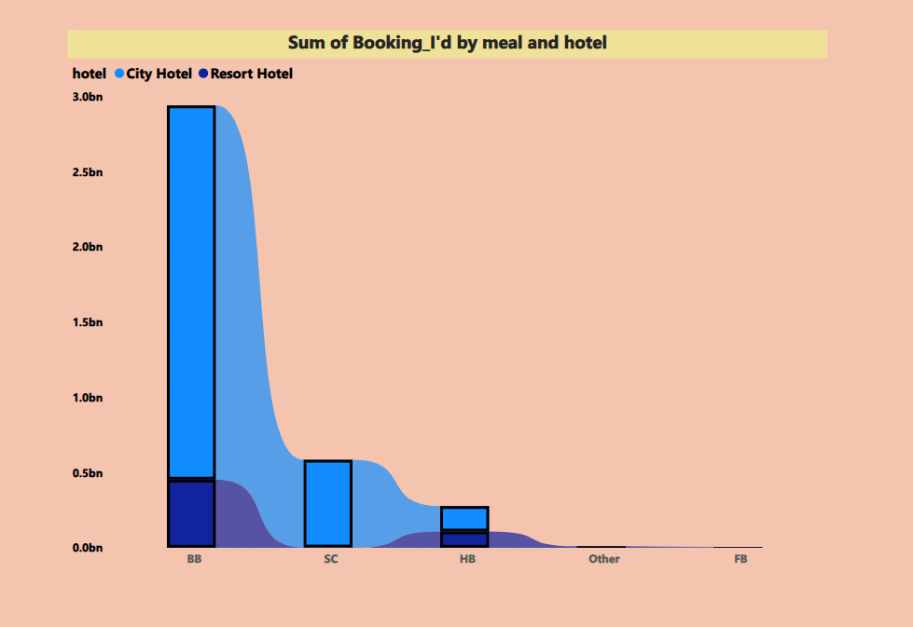
Food preference by guest
Above data shows that guest prefer BB Type Meal most, Hotel management can look into input cost of ingredients required to prepare BB Type meal to maximize profits.
Guest are least interested in others option, Hotel management can analyze to remove the same from their menu in order to reduce their food inventory.

Slide 12
conclusion
In conclusion, the analysis of the hotel reservation dataset underscores the complexity of the hospitality industry and the multifaceted challenges faced by hoteliers in maximizing revenue and guest satisfaction.
The data reveals City hotels, which attract a larger volume of bookings but grapple with a notable cancellation rate, and Resort hotels, which cater to a smaller market share but have potential for growth through strategic enhancements.
We have presented data of hotel booking from July 2015- August 2017 and we are going to present our key findings and our suggestions to hotel management to increase their revenue and profit margins.

Slide 13
Thank You

